Slide 1
Sportizza
PROJECT PROPOSAL
SCS 2202
Supervisor: Dr Shiromi Arunatileka
Co-supervisor: Ishani Fonseka
GROUP 19: SPORTIZZA - PROJECT PROPOSAL

Slide 2
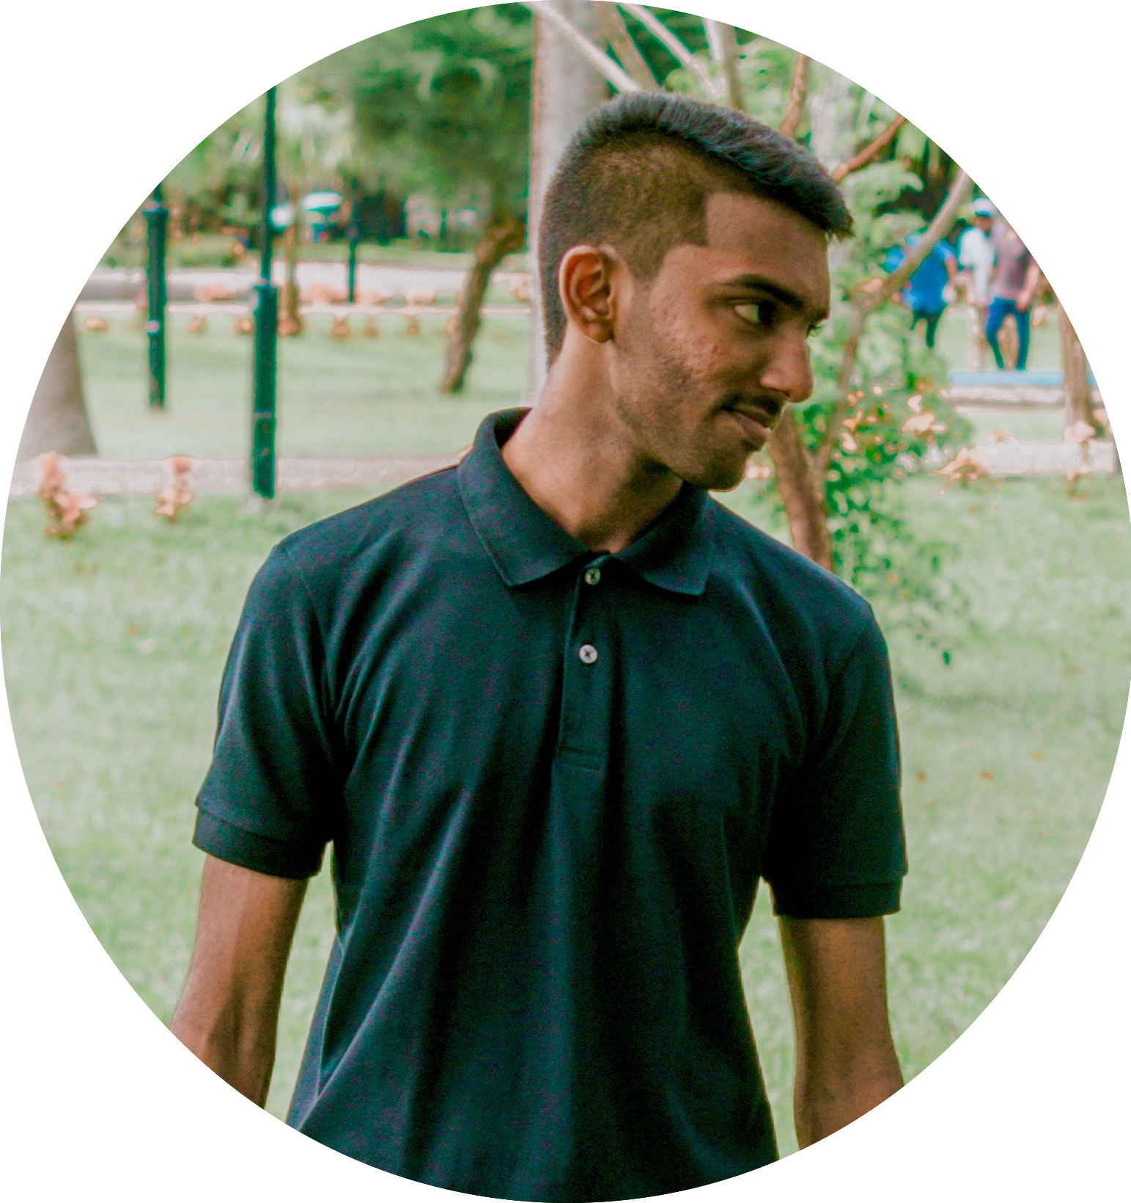
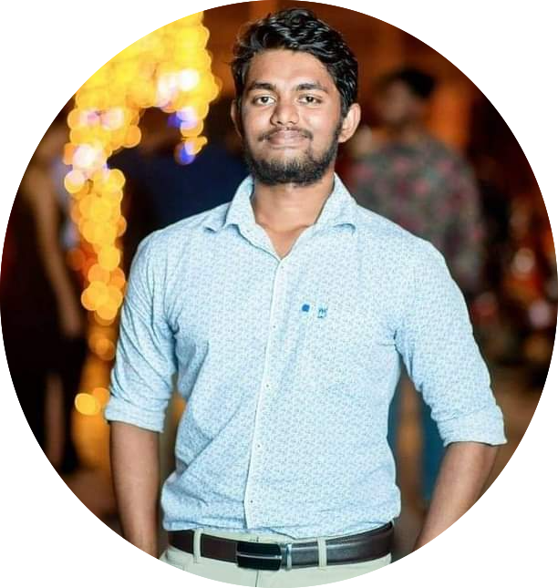
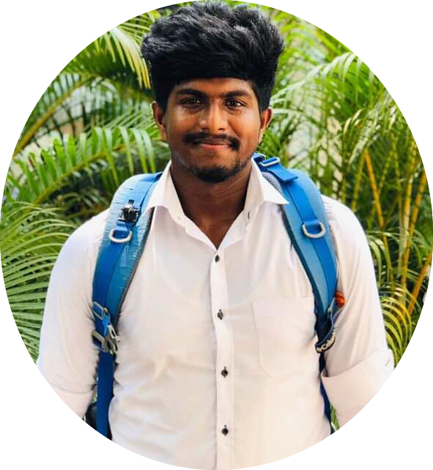
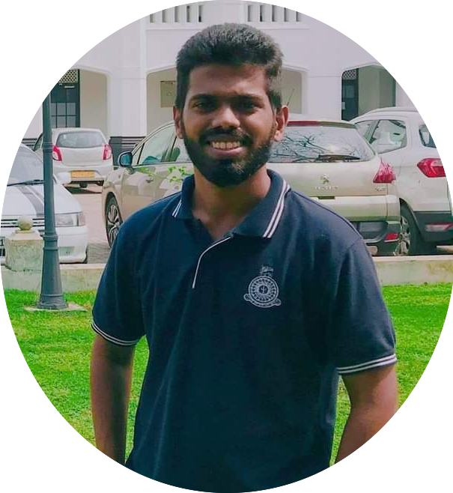
TEAM CS 19
W. L. P. MANETH
WIJETUNGA
2019/CS/194
JONATHAN. P. M.
DASS
2019/CS/028
H. B. S. BHASHITHA
RANASINGHE
2019/CS/131
K.P.D. PRASAD
LAKSHAN
2019/CS/078
GROUP 19: SPORTIZZA - PROJECT PROPOSAL

Slide 3
Contents
01
07
Introduction
Why Sportizza?
Requirement Gathering
Scope & The Business Model
Requirement Analysis
Feasibility Study
Limitations & Constraints
Technologies Used
Workload Distribution
02
08
03
09
04
05
06
GROUP 19: SPORTIZZA - PROJECT PROPOSAL

Slide 4
Introduction
01
GROUP 19: SPORTIZZA - PROJECT PROPOSAL
GROUP 19: SPORTIZZA - PROJECT PROPOSAL

Slide 5


How many grounds did I call to check the availability?
How many calls did I made to confirm MY booking slot?
How many days did we have to share our slots with strangers?
Customer
How many times did outsiders used our facilities pretending to be the booking party?
How many customers didn’t pay for their booked time slot just because they couldn’t use it?
Sports arena
How much effort we put to keep track of our ground bookings?
GROUP 19: SPORTIZZA - PROJECT PROPOSAL

Slide 6
How does it work at the moment?
Start
Call the sports arena
Check the availability
Call another sports arena
No
If available
Make the booking
Provide the details
Yes
Confirm the booking
Use the sports arena
Do the payment
End
GROUP 19: SPORTIZZA - PROJECT PROPOSAL

Slide 7

Why
sportizza ?
02
GROUP 19: SPORTIZZA - PROJECT PROPOSAL
GROUP 19: SPORTIZZA - PROJECT PROPOSAL

Slide 8
Purpose
“ To build an online booking system that allows potential customers to book sports grounds and other sport centres, while providing efficient business processes for the sports grounds and other sports centres to operate competitively.”
GROUP 19: SPORTIZZA - PROJECT PROPOSAL

Slide 9
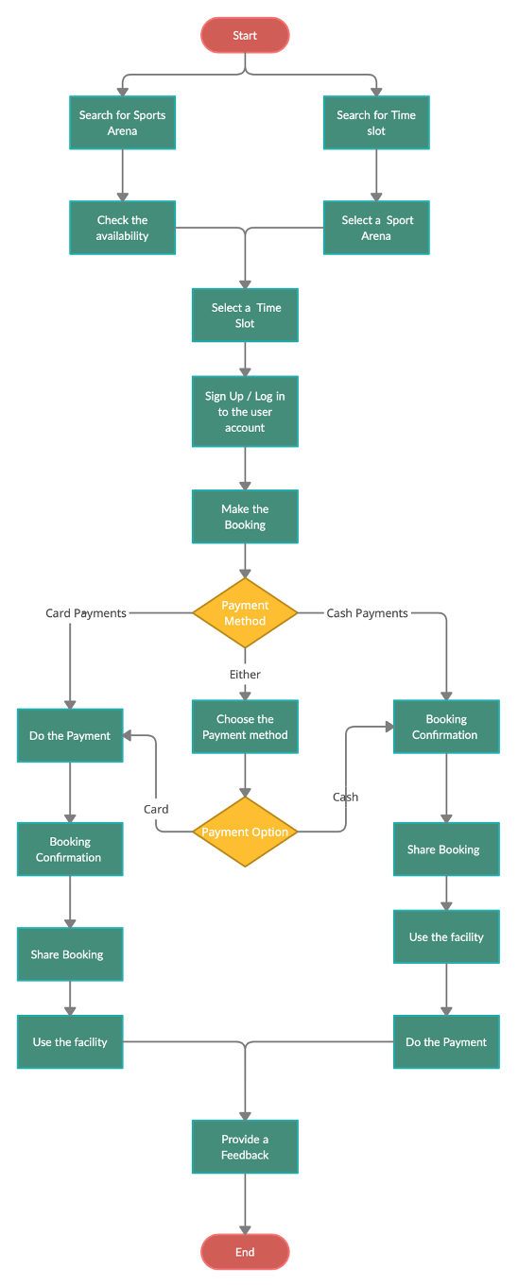
How does it work with our solution?
GROUP 19: SPORTIZZA - PROJECT PROPOSAL

Slide 10

Requirement
Gathering
03
GROUP 19: SPORTIZZA - PROJECT PROPOSAL

Slide 11
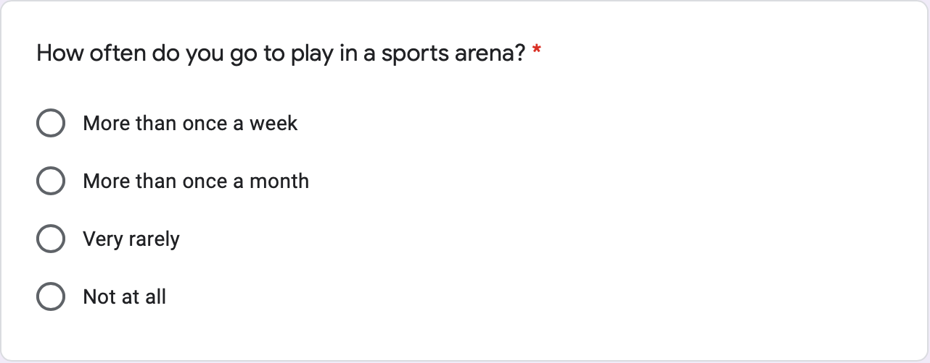
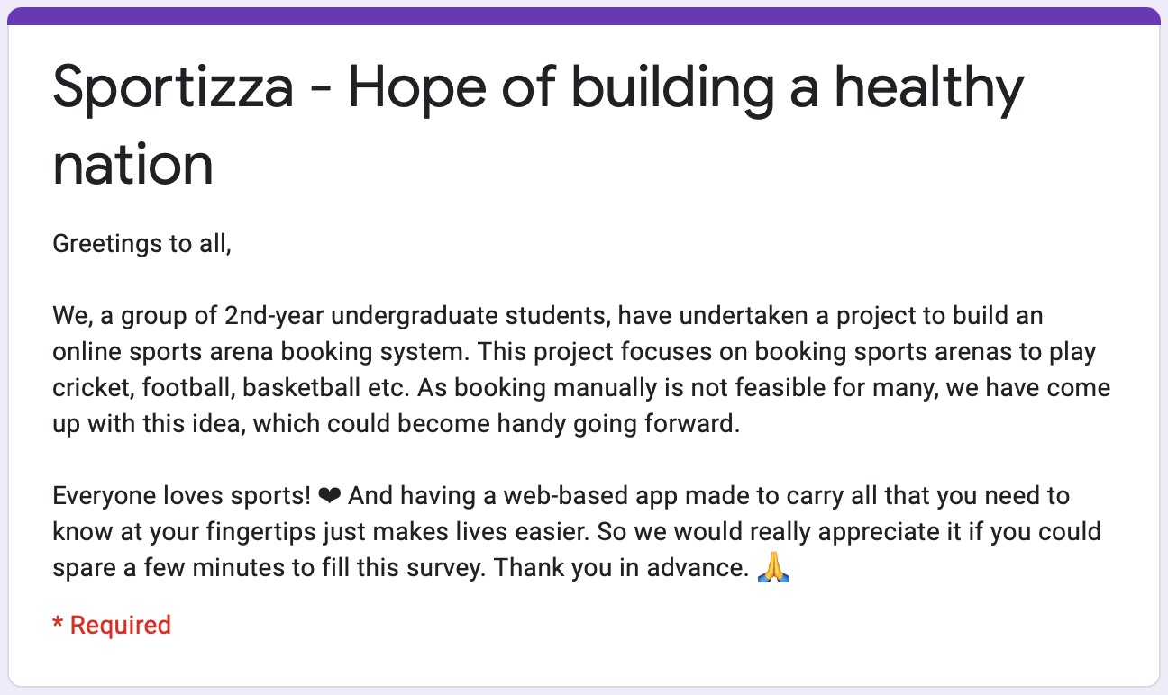
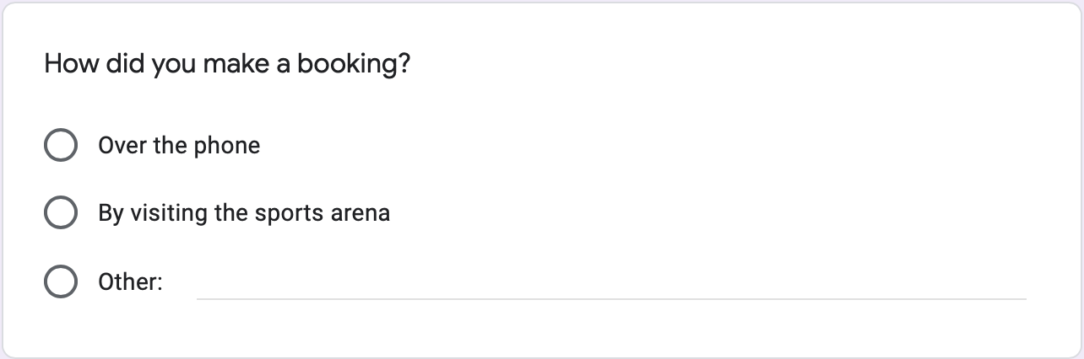
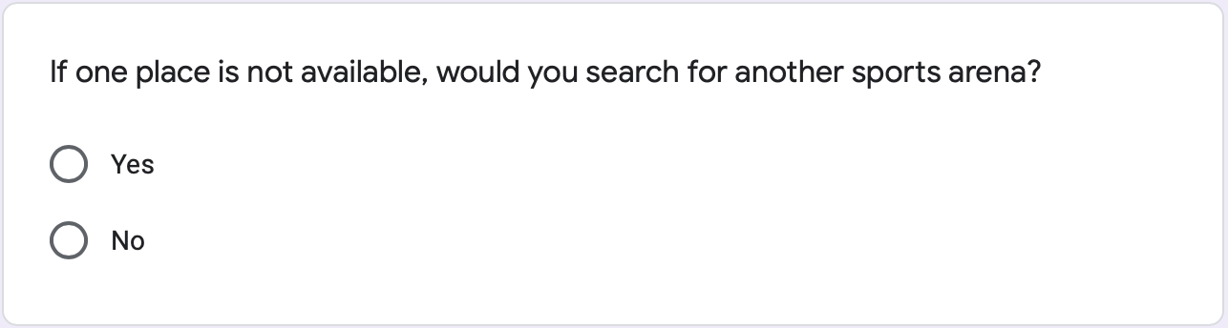
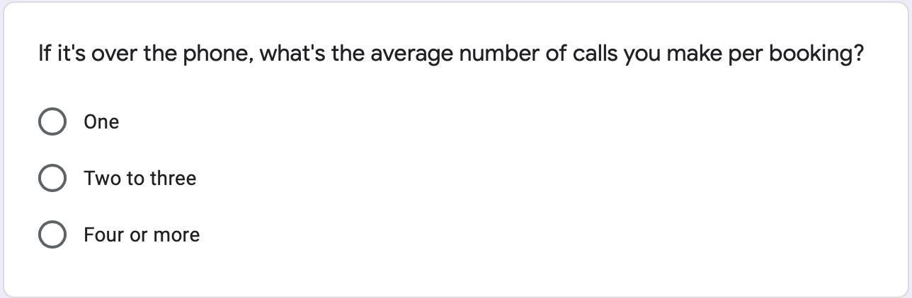
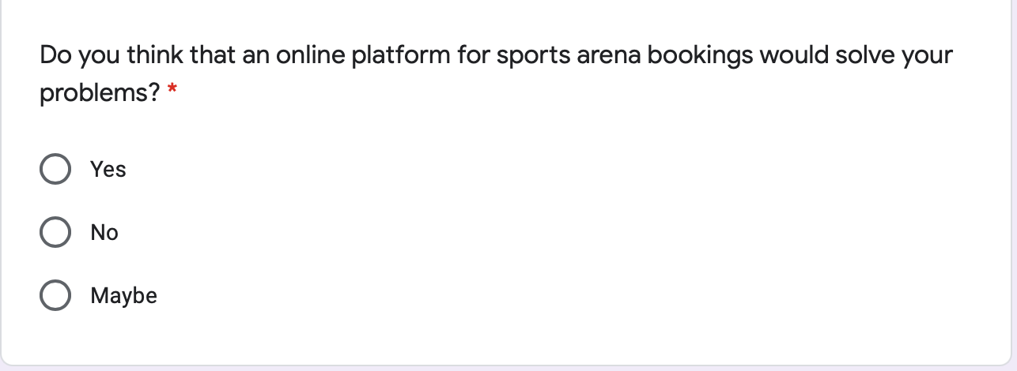
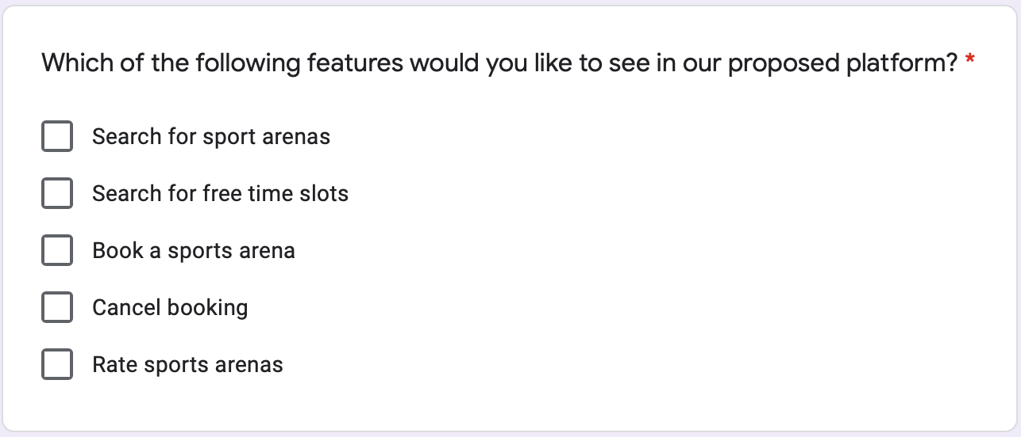
Survey
GROUP 19: SPORTIZZA - PROJECT PROPOSAL

Slide 12
Analytics from the survey
Frequency of visiting a sports arena
Method of making a booking
Avg. no. of calls made per booking
GROUP 19: SPORTIZZA - PROJECT PROPOSAL

Slide 13
Analytics from the survey
Acceptability of the proposed platform
Preferable features to have on the proposed platform
GROUP 19: SPORTIZZA - PROJECT PROPOSAL

Slide 14

Other methods
Experience as a customers.
Brain Storming sessions.
Reverse Thinking.
GROUP 19: SPORTIZZA - PROJECT PROPOSAL

Slide 15




Scope & the business model
04
GROUP 19: SPORTIZZA - PROJECT PROPOSAL

Slide 16
In - Scope
Registration and authentication.
Search for sports arenas.
Make bookings.
Provide ratings to sports arenas.
Share booking confirmation to colleagues via social media.
Sports arena listing in the platform.
Analytics generation for sports arenas.
Payment processing for sports arenas.
GROUP 19: SPORTIZZA - PROJECT PROPOSAL

Slide 17
Out of Scope
Discounts on booking time slots.
Booking rescheduling.
Advertising of open tournaments organised by the sports arena.
Booking time slots with coaches.
Sports equipment merchandising.
GROUP 19: SPORTIZZA - PROJECT PROPOSAL

Slide 18
Any Similar systems?
Sportido, gwsportsapp & Playspots from India
Playfinder from uk & Ireland
“None is available in srilanka!"
GROUP 19: SPORTIZZA - PROJECT PROPOSAL

Slide 19


Business model
5 % Royalty Fee
Zero Fee
Sportizza
Advertising Fee
Customer
Sports arena
*Scalable with merchants & event organisers of sports events
GROUP 19: SPORTIZZA - PROJECT PROPOSAL

Slide 20
Requirement
Analysis
05
GROUP 19: SPORTIZZA - PROJECT PROPOSAL

Slide 21






User identification
01
03
04
06
Visitor
Location manager
Administration staff
02
05
Admin
Booking handling staff
customer
GROUP 19: SPORTIZZA - PROJECT PROPOSAL

Slide 22
Actors
02
Signup
Login/ Logout
Edit profile details
Search for sports arenas
Book sports arena
Do a payment
Share booking via social media
Rate sports arenas and provide reviews
Create my sports arenas list
Cancel booking
View my bookings
Ask help/ support desk
01
Visitor
customer
Search for sports arenas
Ask help/ support desk
GROUP 19: SPORTIZZA - PROJECT PROPOSAL

Slide 23
Actors
03
04
05
Location manager
Administration staff
Booking handling staff
Register for an account
Login/Logout
Edit sports arena profile
Generate reports
Choose payment method
Reply to customer feedbacks and queries
Booking slots manually
View bookings
Emergency booking cancellations
Register for an account
Login/Logout
Edit profile details
Choose payment method
Reply to customer feedbacks and queries
View bookings
Booking Slots manually
Emergency booking cancellations
Login/Logout
View bookings
GROUP 19: SPORTIZZA - PROJECT PROPOSAL

Slide 24
Actors
06
Login/Logout
Verify sports arenas for listing
Remove sports arenas
Remove customers
Remove negative feedbacks after assurance by the sports arena
Help & support
Generate System Reports
Admin
GROUP 19: SPORTIZZA - PROJECT PROPOSAL

Slide 25
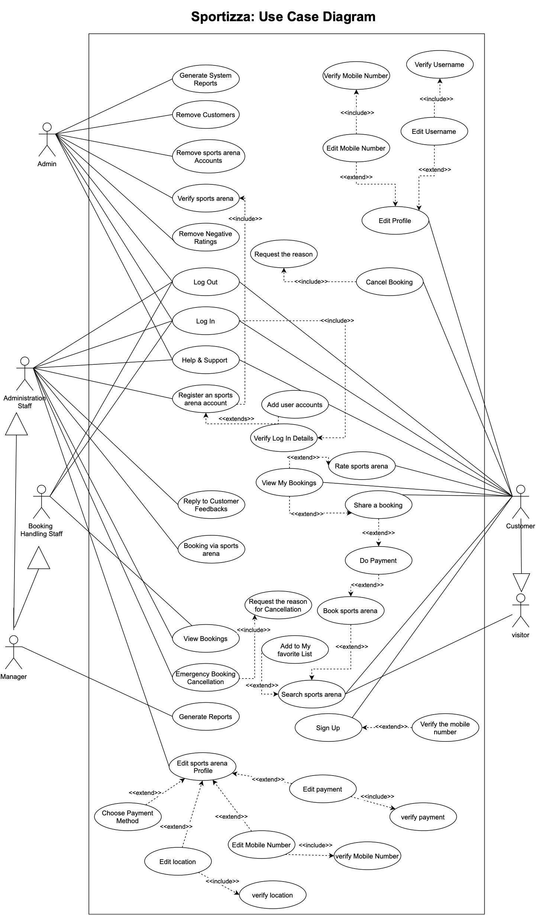
Use case diagram
GROUP 19: SPORTIZZA - PROJECT PROPOSAL

Slide 26
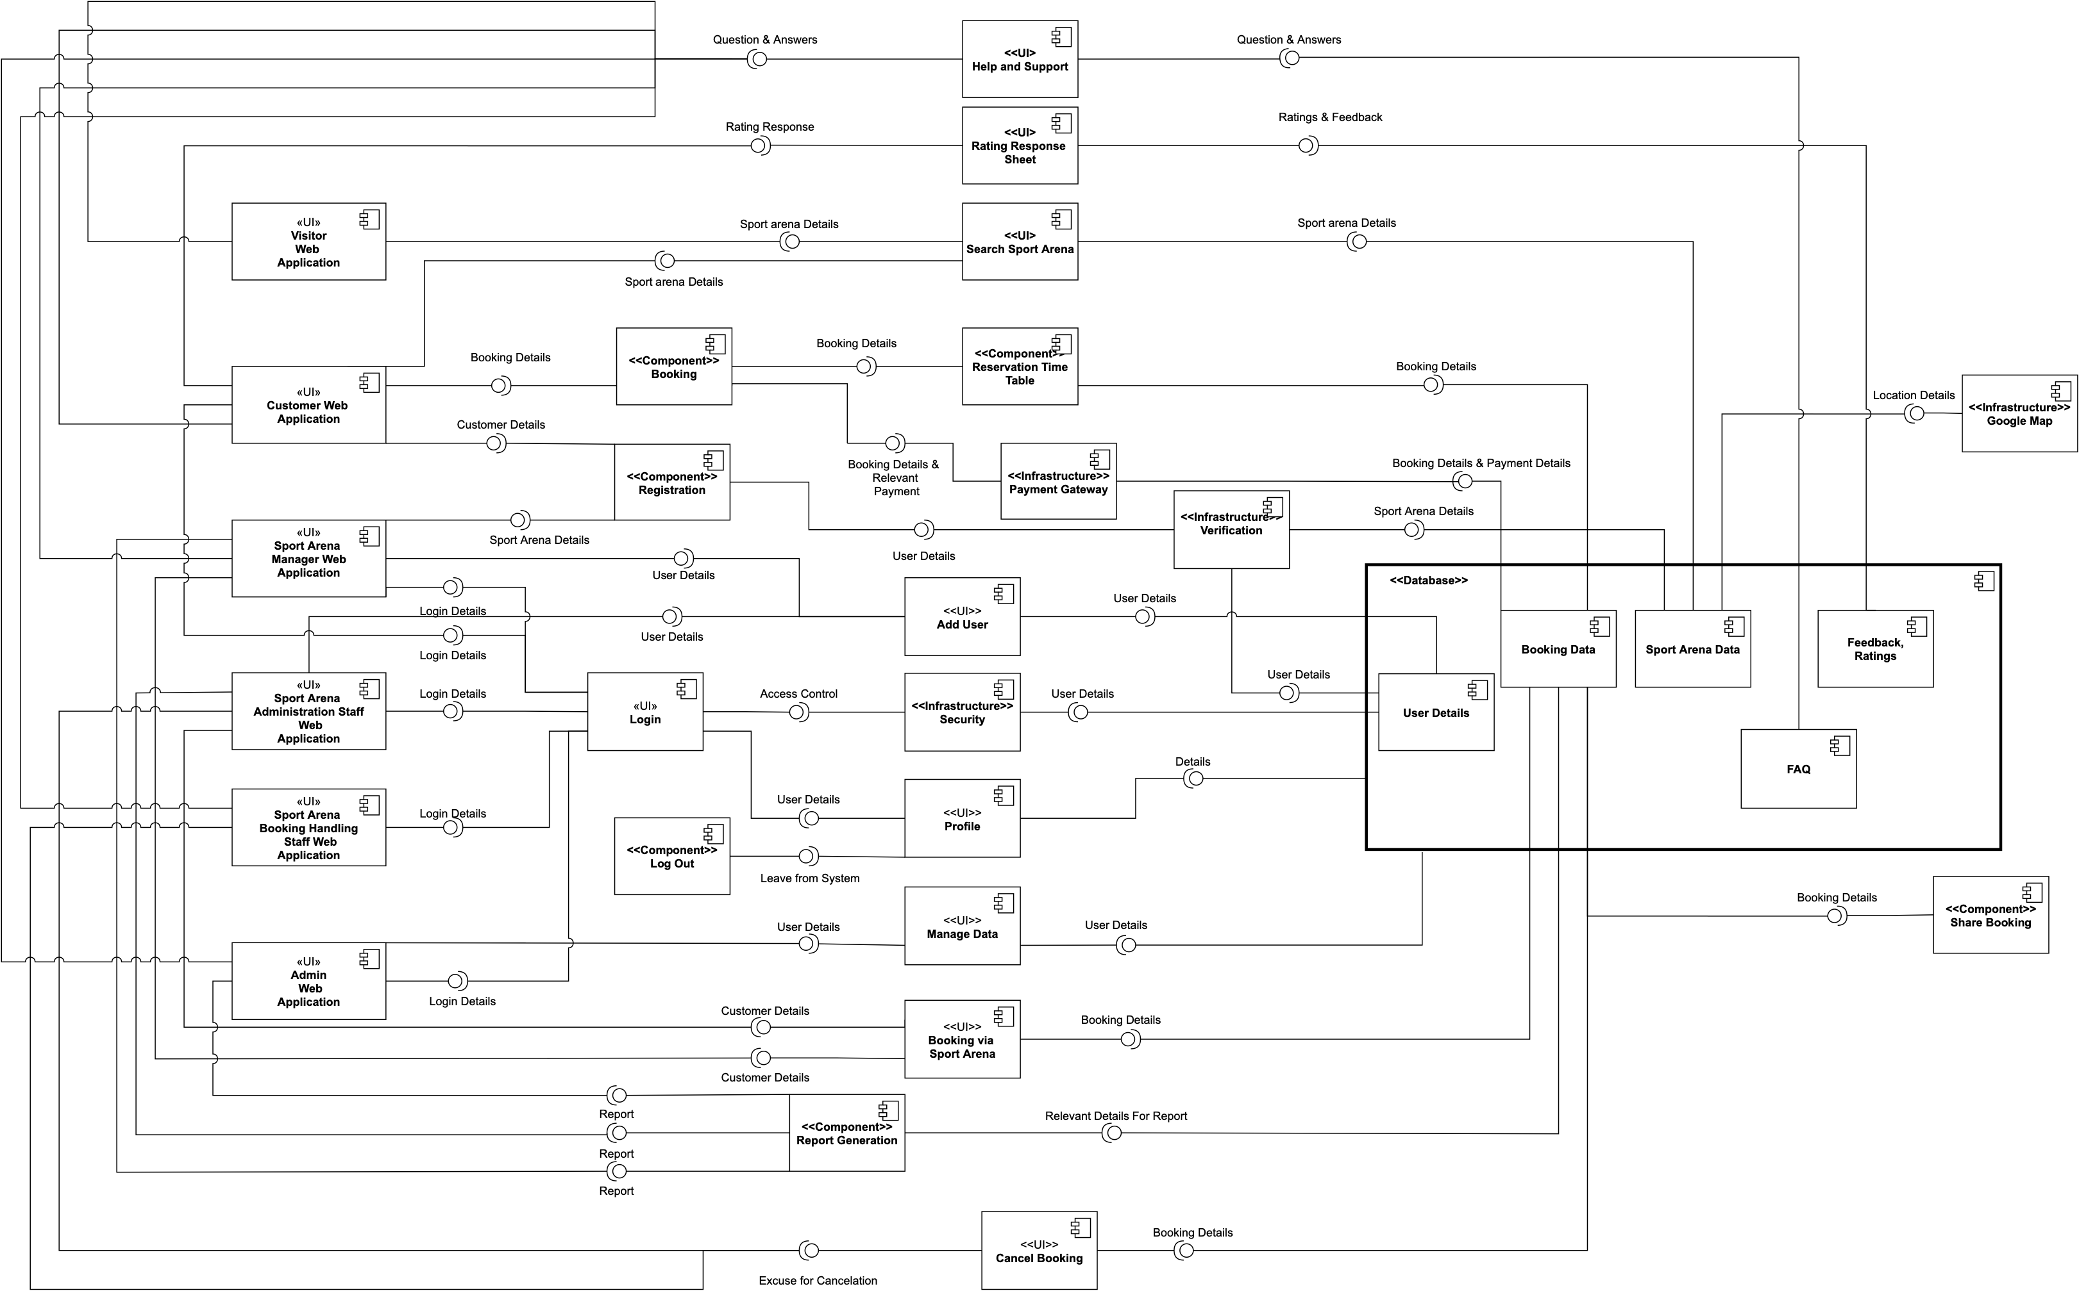
Component diagram
(high-level architecture)
GROUP 19: SPORTIZZA - PROJECT PROPOSAL

Slide 27
Non-functional requirements
01
02
03
04
05
06
Security
Availability
Modifiability
Performance
Testability
usability
What are we going to do to ensure these?
GROUP 19: SPORTIZZA - PROJECT PROPOSAL

Slide 28
Feasibility
Study
06
GROUP 19: SPORTIZZA - PROJECT PROPOSAL

Slide 29
Technical feasibility
Required technologies including all IDEs using for development are free and open source.
Laptops and desktops required to carry out the development with the relevant hardware requirements are owned by the group members.
All above mentioned resources are easily usable within our knowledge boundary.
Hence it’s safe to assume that Sportizza Project is technically feasible.
GROUP 19: SPORTIZZA - PROJECT PROPOSAL

Slide 30
Operational feasibility
To use our application,
Require basic English & IT knowledge.
A mobile device with an Internet connection.
Preferably a Personal computer or a laptop for the location
management staff.
Affordability:
- Customers: Zero fees
- Location Management: 5% mgt fee on each booking. (Separately charged for additional reports).
Hence it’s safe to assume that Sportizza Project is operationally feasible.
GROUP 19: SPORTIZZA - PROJECT PROPOSAL

Slide 31
Legal & ethical feasibility
Sensitive data of the users have to be protected as per GDPR laws.
Hierarchical based login mechanism to prevent access to unauthorised data.
Secure Online payments 3rd party Application for online payment payment processing.
Thus, the proposed platform of is legally and ethically feasible.
GROUP 19: SPORTIZZA - PROJECT PROPOSAL

Slide 32
Economic feasibility
Planning to use PayHere sandbox during the development stage.
For Hosting services, Amazon Web Services’ Free Tier.
All other IDEs and softwares used for development are freely available.
Need to add the cost of domain fees and hosting fees
GROUP 19: SPORTIZZA - PROJECT PROPOSAL

Slide 33
Scheduling feasibility
Waterfall
model
Requirement Analysis
Feasibility study
System design
Implementation
Testing
Deployment
GROUP 19: SPORTIZZA - PROJECT PROPOSAL

Slide 34
Budgeted time
4 members * 10 hours per week = 40 hours per week
40 hours/week *30 weeks = 1200 hours
Risk buffer = 24o hours
Hence, total budgeted time = 1440 hours
*The above time is only a budgeted time and always there can be favourable and adverse variances
GROUP 19: SPORTIZZA - PROJECT PROPOSAL

Slide 35
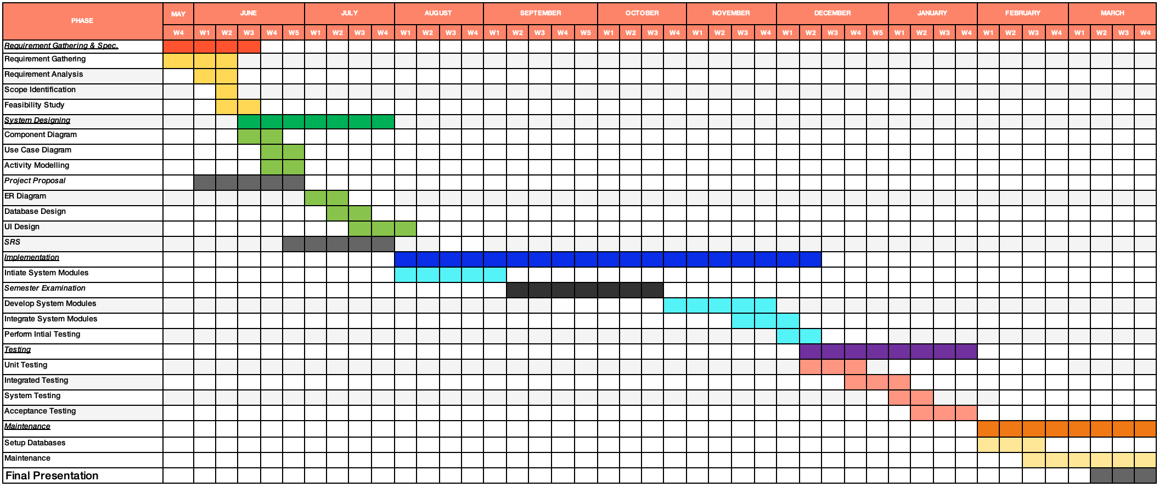
Gantt chart
GROUP 19: SPORTIZZA - PROJECT PROPOSAL

Slide 36

Limitations &
Constraints
07
GROUP 19: SPORTIZZA - PROJECT PROPOSAL

Slide 37
Limitations & constraints
Cash Payments aren’t handled by the platform.
Booking rescheduling is not possible.
Discount code feature is not available at the proposed product.
Government controlled sports arena’s who don’t want to use a third party software might not get registered in sportizza.
Use of waterfall model makes it hard to change the requirements.
GROUP 19: SPORTIZZA - PROJECT PROPOSAL

Slide 38

Technologies
08
GROUP 19: SPORTIZZA - PROJECT PROPOSAL

Slide 39





Frontend, backend & database management
Front end:
Back end & database:
GROUP 19: SPORTIZZA - PROJECT PROPOSAL

Slide 40



Other technologies:
Modules:
Other tools:
Other softwares:
GROUP 19: SPORTIZZA - PROJECT PROPOSAL

Slide 41

Workload
Distribution
09
GROUP 19: SPORTIZZA - PROJECT PROPOSAL

Slide 42
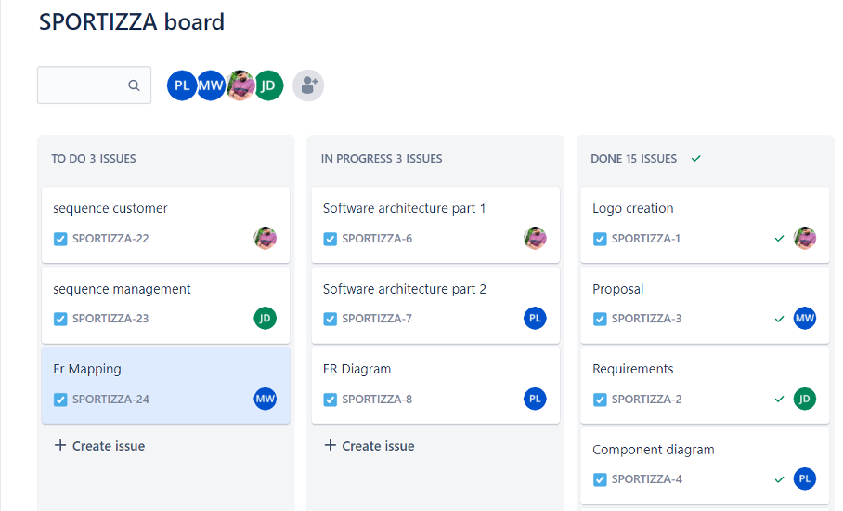
Jira board
Work breakdown between members
GROUP 19: SPORTIZZA - PROJECT PROPOSAL

Slide 43
Questions?
GROUP 19: SPORTIZZA - PROJECT PROPOSAL

